Slide 1

Finding Inconsistency Of Security Information From Unstructured Text
GUIDE – Mrs. Sangeetha K
Assistant Professor
BATCH – 7
Sanggami R – 2017PECS217
Punitha G – 2017PECCS202
Saranya R – 2017PECCS218

Slide 2
INTRODUCTION
Textual data of open source intelligence on the web has become an increasingly important topic across a wide range of domains such as business, law enforcement, military and cyber security.
Social networking sites engage millions of users around the world. The user’s interactions with these social sites, such as twitter and Face book have a tremendous impact and occasionally undesirable repercussions for daily life.
The detection of spammers and identification of fake users on twitter has become a common area of research in Contemporary Online Social Networks (OSNs).
We show that Supervised Machine Learning can overcome all the bottlenecks.
We here find the conflict, disagreement or mismatch of the secured information from the unstructured data. Text analyses and classification is made to detect the Cyber bullying activities, Fake News Identification and Spamming.

Slide 3
LITERATURE SURVEY
Year of publishing | Author name | Title of the paper | Merits | Demerits
2019 | Gauri Jain, Manisha Sharma & Basant Agarwal | Spam detection in social media using convolutional and long short term memory neural network | The proposed approach highly helpful in detecting the spam in short noise text - a challenging one due to sparseness and irregularities of language. | Overfit especially with the low volume of data.
LINK | https://link.springer.com/article/10.1007/s10472-018-9612-z

Slide 4
LITERATURE SURVEY
Year of publishing | Author name | Title of the paper | Merits | Demerits
2019 | Antonio Pascucci; Vincenzo Masucci; Johanna Monti | Computational Stylometry and Machine Learning for Gender and Age Detection in Cyberbullying Texts | We can able to categorize and analyze the Cyberbullying text by grouping into taxonomy(linguistic rules) to detect the gender and age of cyber bullies. | 1.Focusing on the categories only based on written text 2.Less number of stylometric features are developed.
LINK | https://ieeexplore.ieee.org/document/8925101

Slide 5
LITERATURE SURVEY
Year of publishing | Author name | Title of the paper | Merits | Demerits
2018 | Chen Chang, Jianjun Cao, Qibin Zheng, Guojun Lv, Nianfeng Weng | An Unsupervised Approach of Truth Discovery from Multi-sourced Text Data | 1. Easily identifies which piece of information is trustworthy from structured data. 2. It achieves the best performance by capturing the semantic meaning of the text data. | 1. It fails to meet the strong need to extract trustworthy information from raw text data. 2. Less effective for some complex situations such as the number of answers to each question is not enough.
LINK | https://ieeexplore.ieee.org/document/8923742/authors

Slide 6
LITERATURE SURVEY
Year of publishing | Author name | Title of the paper | Merits | Demerits
2017 | Sagar Gharge; Manik Chavan | An integrated approach for malicious tweets detection using NLP | We use SVM algorithm to detect spam accounts which gives a standard result. | It can be applied only to detect spam on twitter focusing mainly on detection of tweets, Not any other thing.
LINK | https://ieeexplore.ieee.org/document/7975235

Slide 7
LITERATURE SURVEY
Year of publishing | Author name | Title of the paper | Merits | Demerits
2016 | Michele Di Capua; Emanuel Di Nardo; Alfredo Petrosino | Unsupervised cyber bullying detection in social networks | Use of unsupervised approach to analyze cyber bullying with several hand crafted features that used to catch the semantic and syntactic communication behavior of the cyber bullies. | Less accuracy and performance results.
LINK | https://ieeexplore.ieee.org/document/7899672

Slide 8
PROBLEM STATEMENT
The objective is to overcome the inconsistency of the information in the form of text that is available on the internet.
The inconsistency in the text may lead to threats, attacks, and negative effects by the fraudsters to the users.
To overcome the threat-free and reduce negative effects ,text classification and analysis are made and detection of fake news identification , spamming , cyber bulling activity is made.
Detection is done with the help of supervised machine learning algorithm model.
By applying different model to each domain accuracy is found. By doing this we can predict which model will give a higher accuracy rate.
The model with high accuracy can help to detect fake news identification, spamming, and cyber bullying activities effectively.

Slide 9
DEVELOPMENT ENVIRONMENT
HARDWARE REQUIREMENTS
System : i5
Hard disk : 500 GB.
Mouse : Logitech.
RAM : 4 GB.
SOFTWARE REQUIREMENTS
Operating system : Windows XP.
Coding language : Python

Slide 10
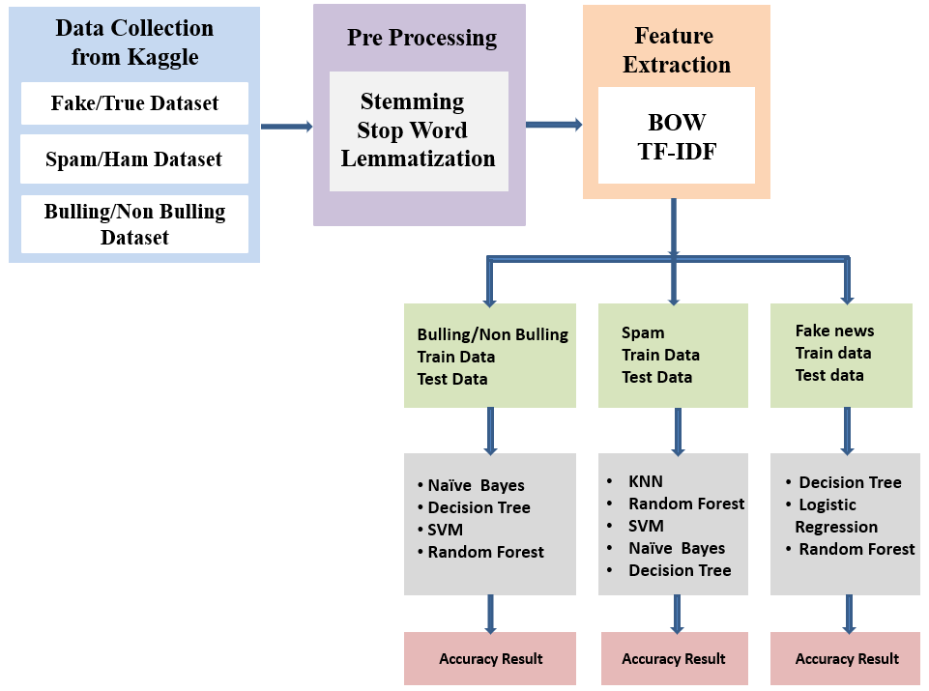
SYSTEM ARCHITECTURE

Slide 11
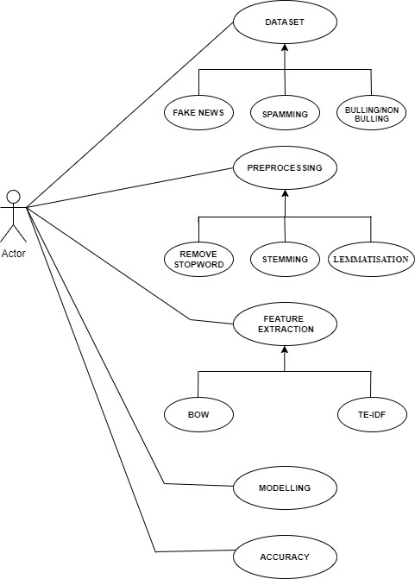
SYSTEM DESIGN-USECASE DIAGRAM

Slide 12
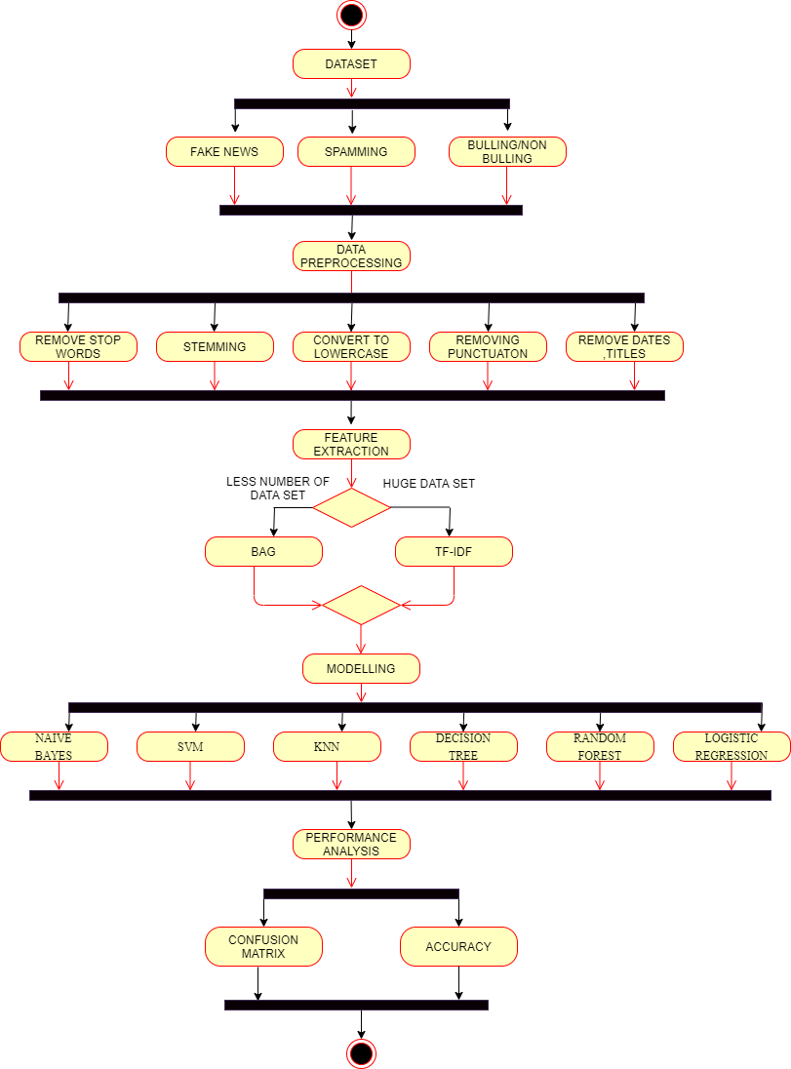
ACTIVITY DIAGRAM
BOW

Slide 13
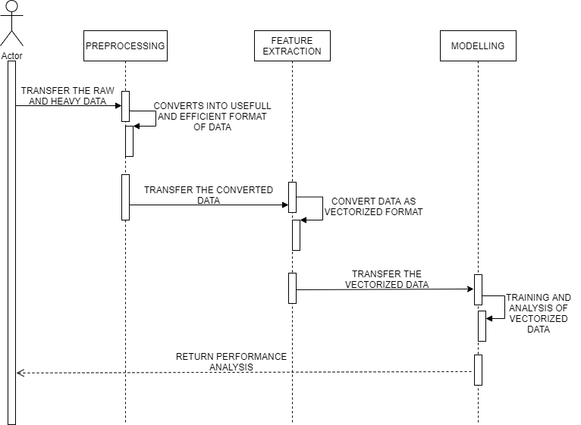
SEQUENCE DIAGRAM

Slide 14
MODULES
The five modules in our project are
Data Collection
Pre- Processing
Data Exploration
Feature Extraction
Modelling

Slide 15
MODULE DESCRIPTION
DATA COLLECTION
Unstructured data which is been modified to structured format is collected from Kaggle.
Peculiar datasets is collected for each (i.e.,) bullying and non-bullying, Fake news, Spamming.
Collection of data is most important tasks of any machine learning projects. Because the input we feed to
the algorithms is data.
So, the algorithms efficiency and accuracy depend upon the correctness and quality of data collected.

Slide 16
DATASETS
CYBER BULLYING
https://www.kaggle.com/dataturks/dataset-for-detection-of-cybertrolls/notebooks
File format - .json
Data Count - 20001
FAKE NEWS
https://www.kaggle.com/clmentbisaillon/fake-and-real-news-dataset
File format - .csv
Data Count - Fake Dataset = 23503 ; True Dataset = 21418
SPAMMING
https://www.kaggle.com/uciml/sms-spam-collection-dataset
File format - .csv
Data Count - 5573

Slide 17
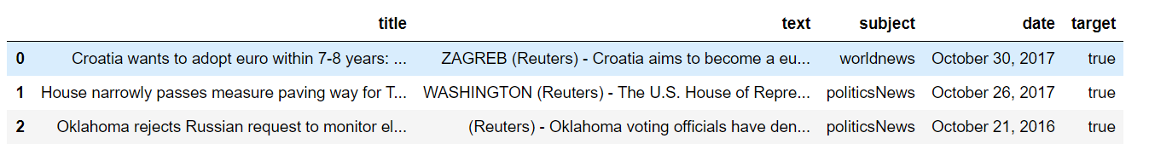
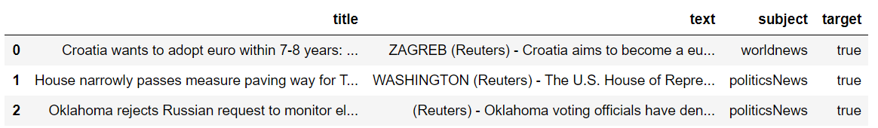
PRE-PROCESSING
Data Pre-processing we transform the raw data into a useful and efficient format by removing noise and inconsistent data. So, it creates the reliable consistent data that improves the efficiency of the training data for analysis and also enables accurate decision – making.
1. Removing date (Attribute not used for analysis)

Slide 18
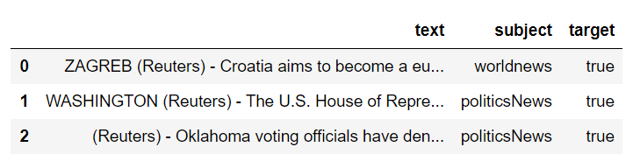
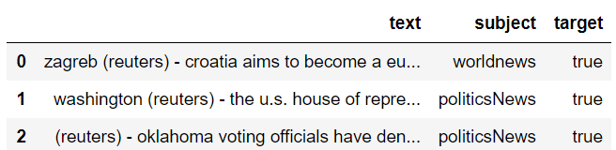
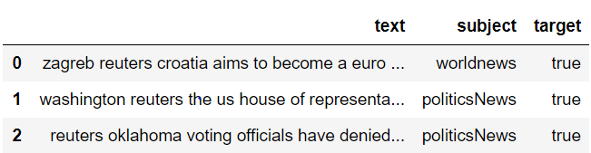
2. Removing the title (we will only use the text)
3. Convert to lowercase
4. Remove punctuation

Slide 19
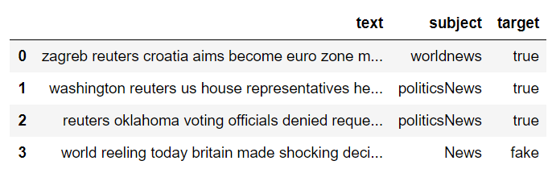
5. Removing stopwords
6. Stemming
Stemming just removes or stems the last few characters of a word, often leading to incorrect meanings and spelling.
e.g., adjustable - > adjust ,formality - > formal
7. Lemmatisation
Lemmatization considers the context and converts the word to its meaningful base form.
e.g., playing, plays, played - > play
am, are, is -> be

Slide 20
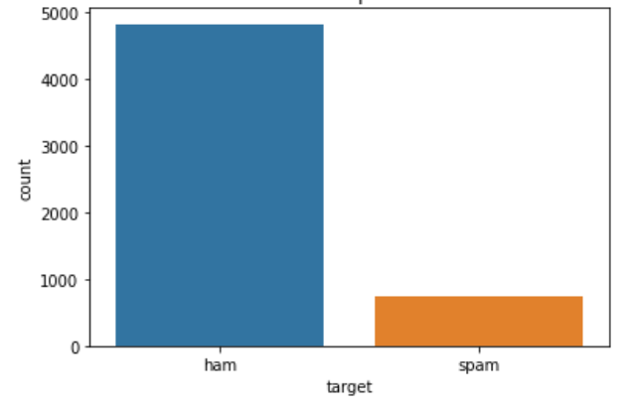
DATA EXPLORATION
We use visual exploration to understand what is in a dataset and the characteristics of the data. Here the characteristics are size, amount of data, completeness of data, correctness of the data and possible relationships.
Spamming – Distribution of spam and ham

Slide 21
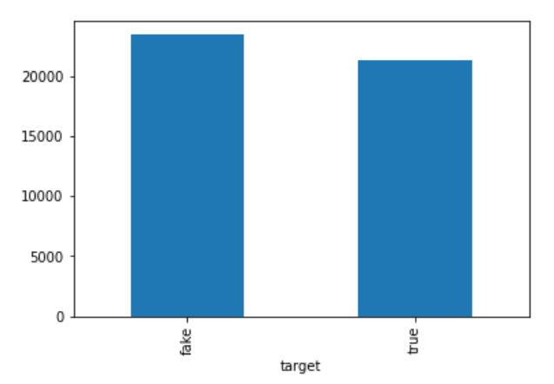
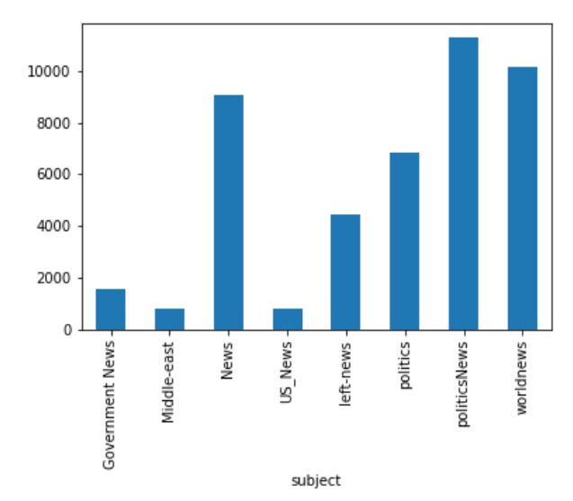
Fake News – No. of fake and real articles
Fake News – Articles per subject

Slide 22
FEATURE EXTRACTION
Bag Of Words
A very common feature extraction procedures for sentences and documents is the bag-of-words approach (BOW). In this approach, we look at the histogram of the words within the text, i.e. considering each word count as a feature.
e.g.,
Step 1: Collect data
It was the best of times, It was the worst of times, It was the age of wisdom, It was the age of foolishness,

Slide 23
Step 2: Design the vocabulary
Now we can make a list of all of the words in our model vocabulary.
The unique words here (ignoring case and punctuation) are:
“it”, “was”, “the”, “best”, “of”, “times”, “worst”, “age”, “wisdom” “foolishness”
That is a vocabulary of 10 words from a corpus containing 24 words.
Step 3: Create document vectors
First document (“It was the best of times“) and convert it into a binary vector.
The scoring of the document would look as follows:
“it” = 1 “was” = 1 “the” = 1 “best” = 1 “of” = 1 “times” = 1 “worst” = 0
“age” = 0 “wisdom” = 0 “foolishness” = 0
“it was the best of times” = [1, 1, 1, 1, 1, 1, 0, 0, 0, 0]
"it was the worst of times" = [1, 1, 1, 0, 1, 1, 1, 0, 0, 0]
"it was the age of wisdom" = [1, 1, 1, 0, 1, 0, 0, 1, 1, 0]
"it was the age of foolishness" = [1, 1, 1, 0, 1, 0, 0, 1, 0, 1]

Slide 24
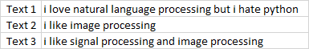
TF-IDF
TF-IDF is a statistical measure that evaluates how relevant a word is to a document in a collection of documents.
e.g.,
We have 3 texts and we need to vectorize these texts
Step 1
Create a term frequency matrix where rows are documents and columns are distinct terms throughout all documents.
Count word occurrences in every text.
Term frequency = No. of repetition of words in sentence / No. of words in a sentence

Slide 25
Step 2
Compute inverse document frequency (IDF) using the previously explained formula.
IDF = log (No of sentences / No of sentences containing words)
Step 3
Multiply TF matrix with IDF respectively

Slide 26
MODELLING
In modeling, we are splitting the data as train and test. This is to estimate the performance of machine learning algorithms i.e., used to make predictions on the data not used to train the model.
Supervised Machine Learning Algorithm used here are,
SPAMMING | FAKE NEWS | BULLING/NON-BULLING
Naïve Bayes SVM KNN Decision Tree Random Forest | Decision Tree Logistic Regression Random Forest | Naïve Bayes Logistic Regression SVM Decision Tree

Slide 27
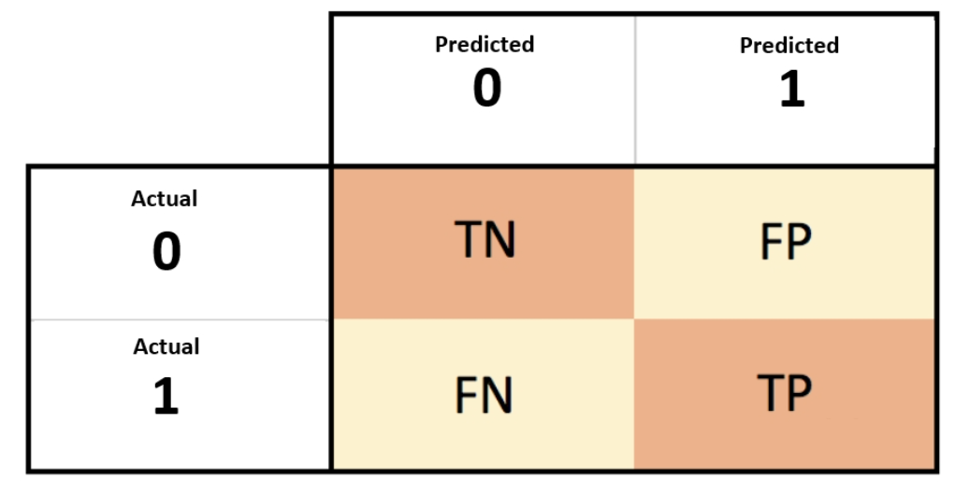
PERFORMANCE ANALYSIS
Confusion Matrix
Accuracy = TP+TN
TP+TN+FP+FN

Slide 28
PERFORMANCE ANALYSIS
FAKE NEWS
Model | Accuracy
Decision Tree | 99.54%
Logistic Regression | 98.74%
Random Forest | 99.12%

Slide 29
PERFORMANCE ANALYSIS
BULLING/NON-BULLING
Model | Accuracy
Decision Tree | 85.82%
Naïve Bayes | 76.58%
SVM | 90.96%
Random Forest | 95.24%

Slide 30
PERFORMANCE ANALYSIS
SPAMMING
Model | Accuracy
Naïve Bayes | 98.26%
SVM | 83.43%
KNN | 86.06%
Decision Tree | 97.30%
Random Forest | 97.96%

Slide 31
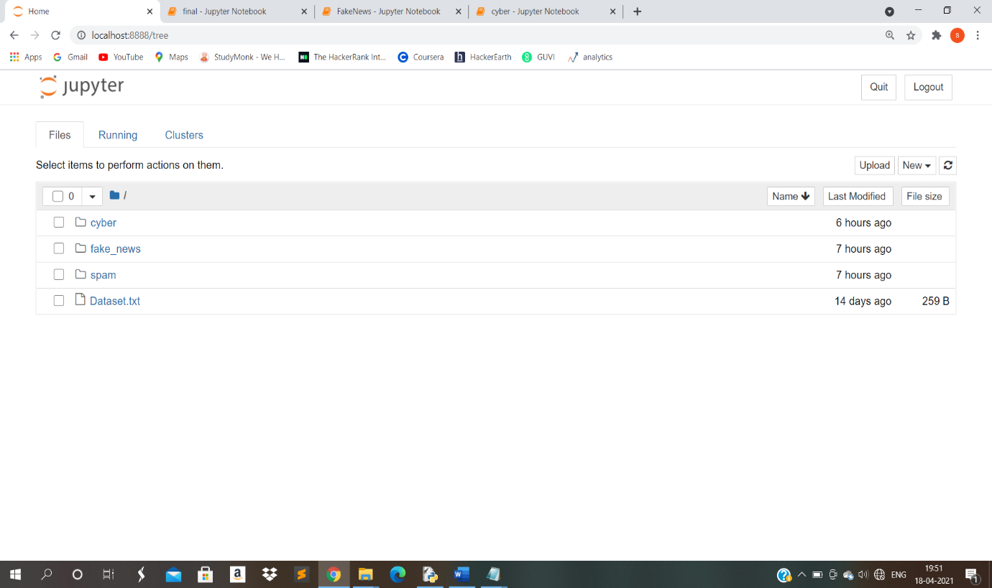
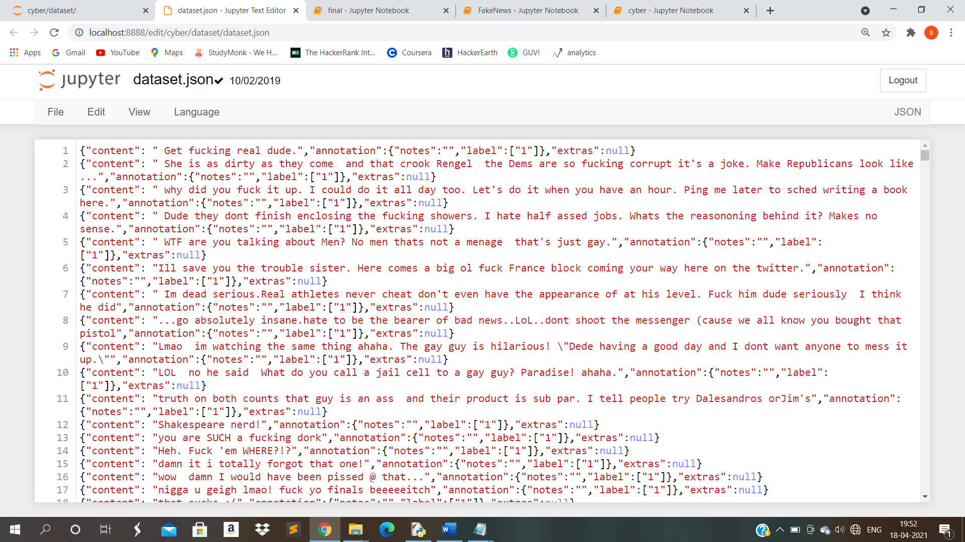
SCREEN SHOTS
Coding Folders
Cyber Bullying Dataset

Slide 32
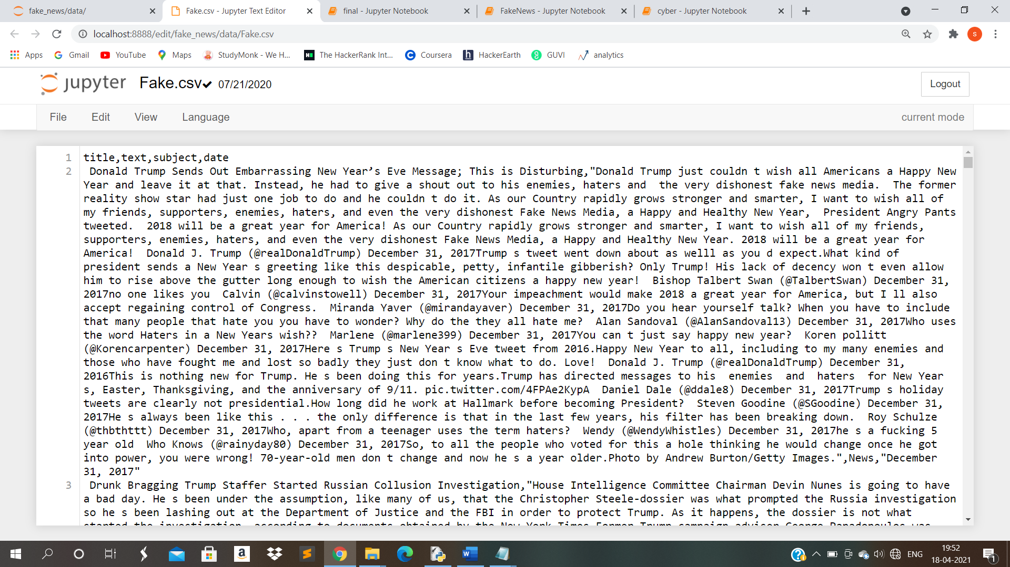
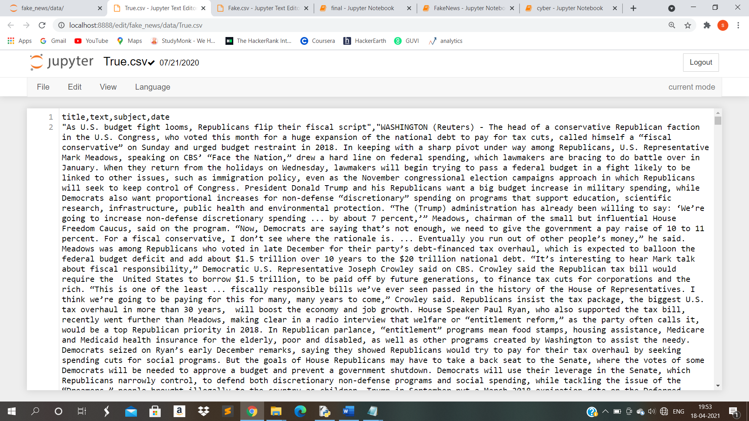
Fake News – Fake Dataset
Fake News – True Dataset

Slide 33
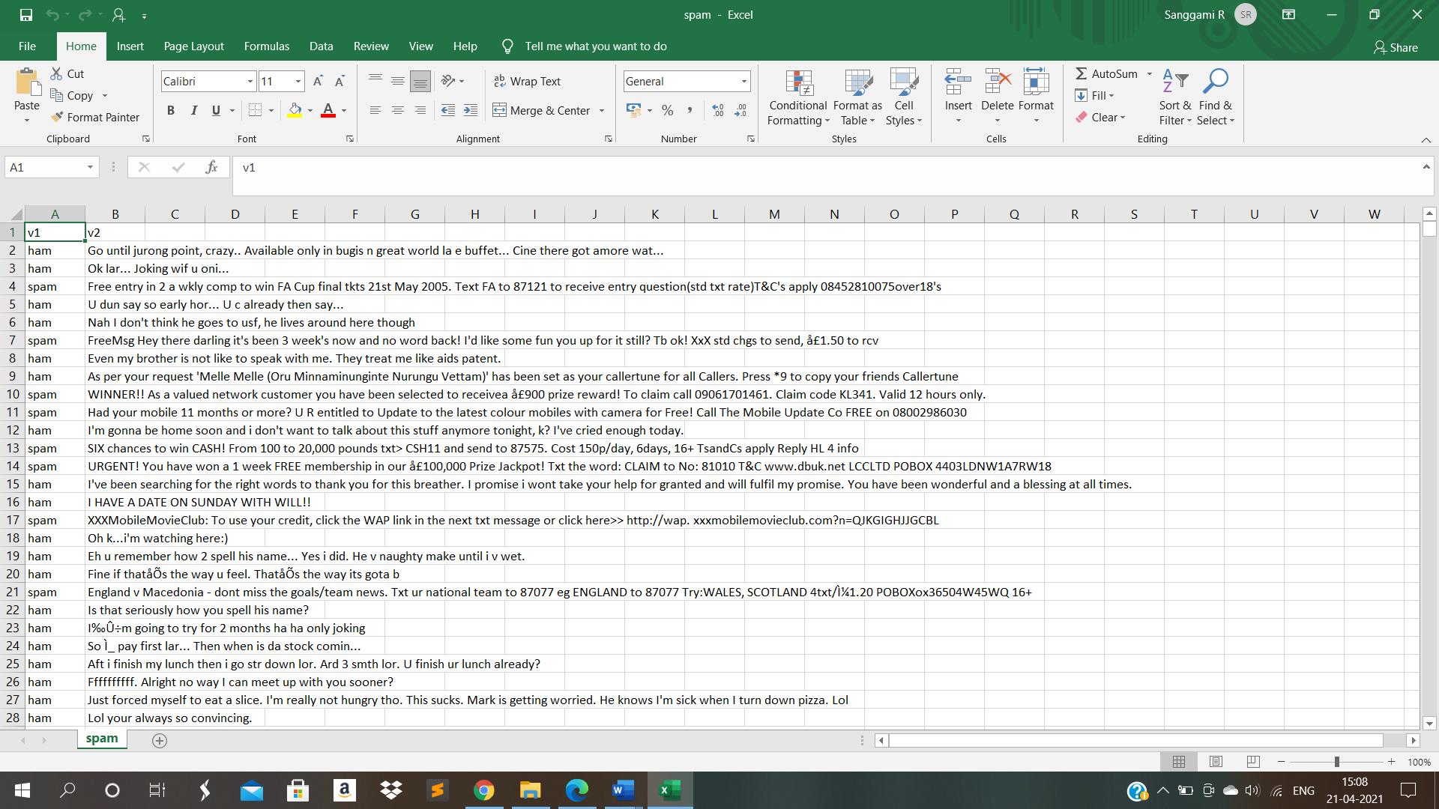
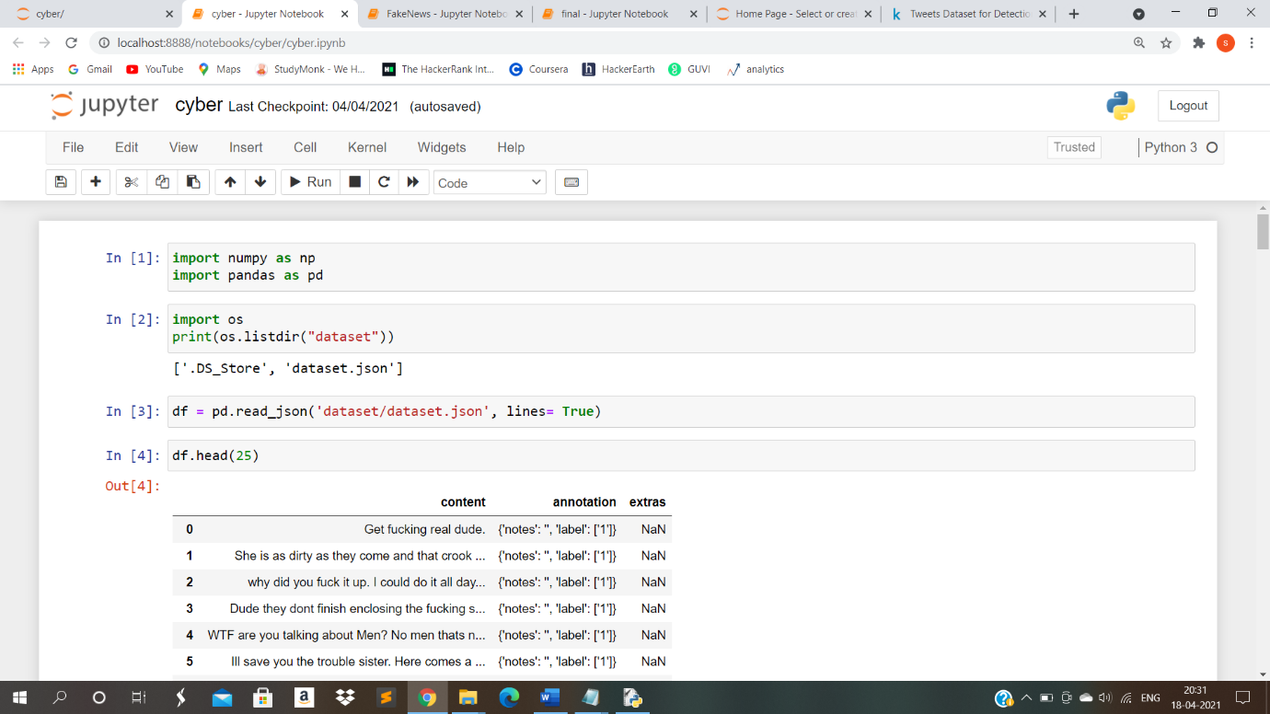
Spamming Dataset
Cyber Bullying Code Sample

Slide 34
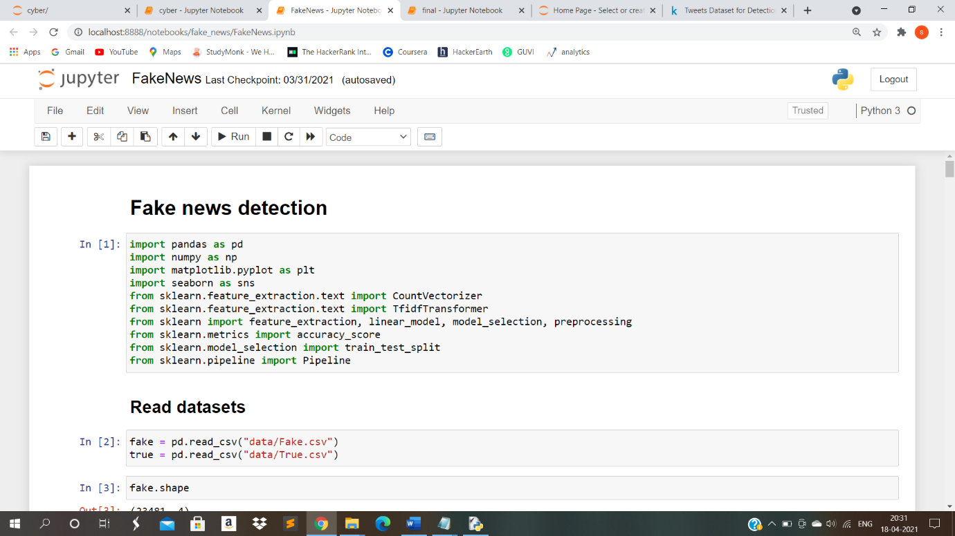
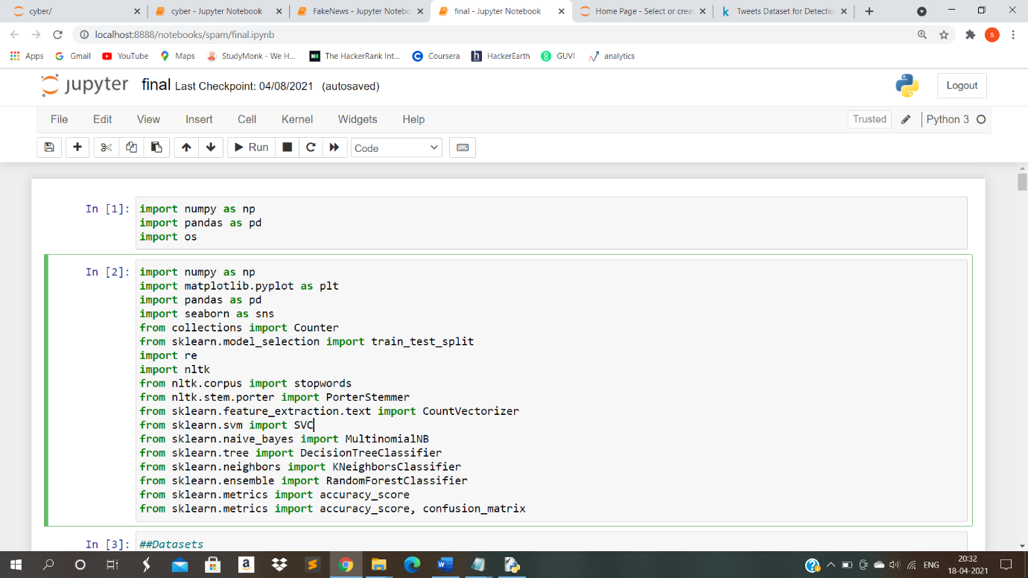
Fake News- Code Sample
Spamming- Code Sample

Slide 35
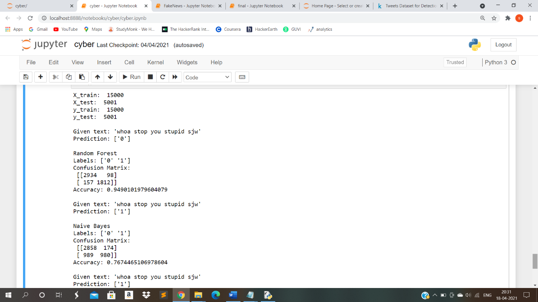
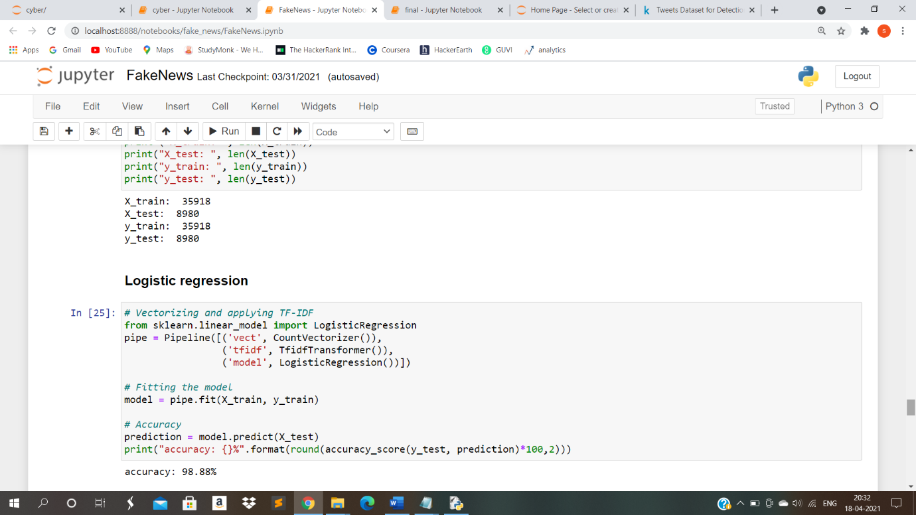
Cyber Bullying Output Sample
Fake News Output Sample

Slide 36
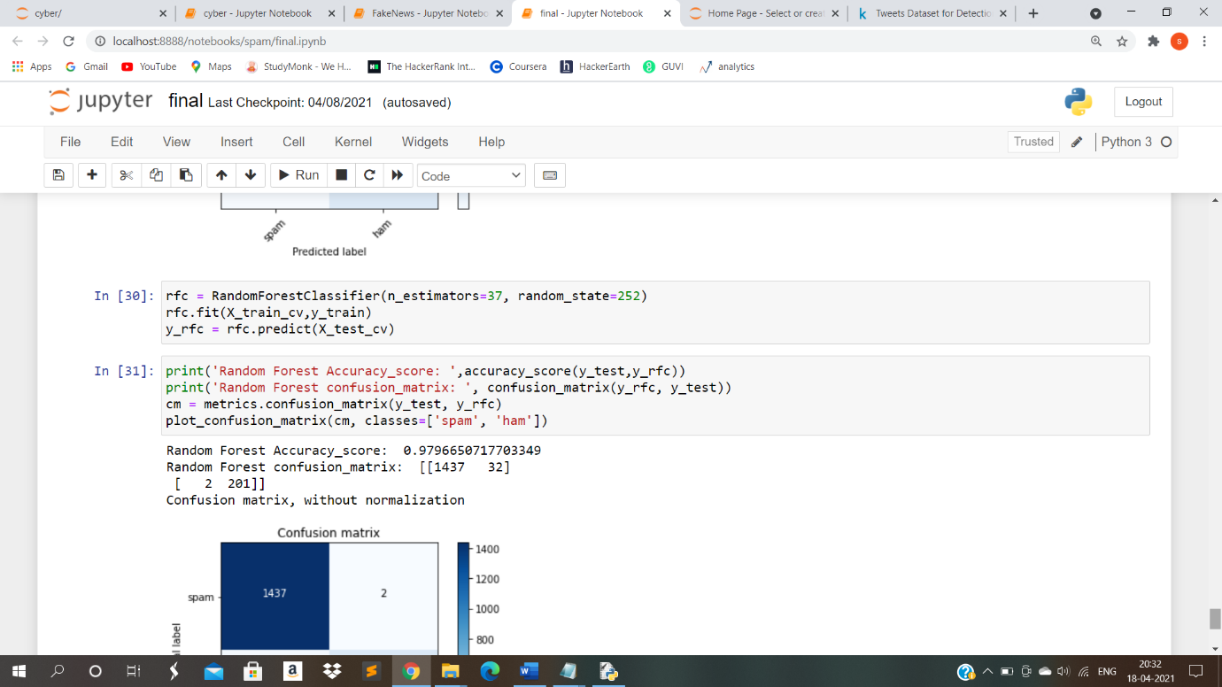
Spamming Output Sample

Slide 37
CONCLUSION
Spreading of false information and bullying in social media have become serious issues these days and a system that is able to detect such texts should surely be of great use.
So text analysis is made to find the inconsistencies of the text and subject to various supervised machine learning algorithms by providing the accuracy of the best model to resolve the issues.
This way we can help people to know more informed decisions also they will not be fooled into thinking what others want to manipulate them into believing.
By this, the consequences of bullying, fake news, and spamming can be reduced.

Slide 38
PUBLICATION DETAILS
“FINDING INCONSISTENCY OF SECURITY INFORMATION FROM UNSTRUCTURED TEXT” is been published under International Research Journal of Engineering and Technology (IRJET)
(https://www.irjet.net/).
IRJET is a peer-reviewed journal which focus on current trends of research.
IRJET Volume 8, Issue 4, April 2021 https://www.irjet.net/volume8-issue4 (S.No: 302)
Manuscript - https://www.irjet.net/archives/V8/i4/IRJET-V8I4302.pdf

Slide 39
REFERENCES
A. Gupta and R. Kaushal, ‘‘Improving spam detection in online social networks,’’ in Proc. Int. Conf. Cogn. Comput. Inf. Process. (CCIP), Mar. 2015, pp. 1–6.
A. Gupta, H. Lamba, and P. Kumaraguru, ‘‘1.00 per RT #BostonMarathon # prayforboston: Analyzing fake content on Twitter,’’ in Proc. eCrime Researchers Summit (eCRS), 2013, pp. 1–12.
B. Erçahin, Ö. Aktaş, D. Kilinç, and C. Akyol, ‘‘Twitter fake account detection,’’ in Proc. Int. Conf. Comput. Sci. Eng. (UBMK), Oct. 2017, pp. 388–392.
C. Buntain and J. Golbeck, ‘‘Automatically identifying fake news in popular Twitter threads,’’ in Proc. IEEE Int. Conf. Smart Cloud (SmartCloud), Nov. 2017, pp. 208–215.
C. Chen, J. Zhang, Y. Xie, Y. Xiang, W. Zhou, M. M. Hassan, A. AlElaiwi, and M. Alrubaian, ‘‘A performance evaluation of machine learning-based streaming spam tweets detection,’’ IEEE Trans. Comput. Social Syst., vol. 2, no. 3, pp. 65–76, Sep. 2015.
F. Benevenuto, G. Magno, T. Rodrigues, and V. Almeida, ‘‘Detecting spammers on Twitter,’’ in Proc. Collaboration, Electron. Messaging, AntiAbuse Spam Conf. (CEAS), vol. 6, Jul. 2010, p. 12.
v

Slide 40
THANK YOU

